Slide 1

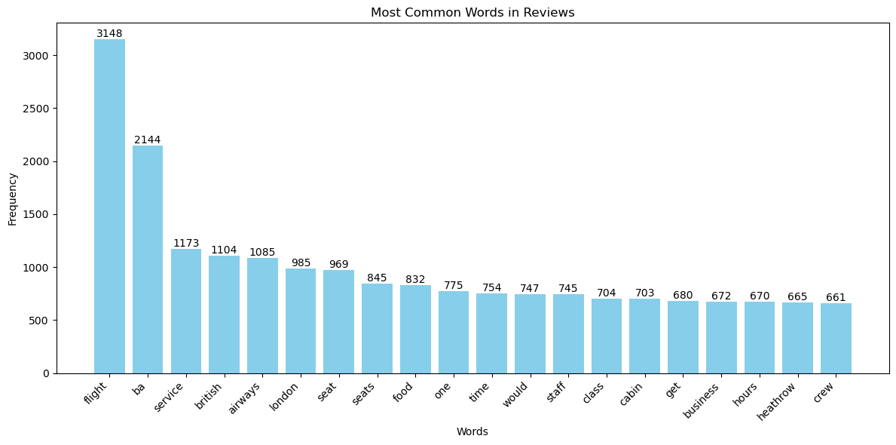
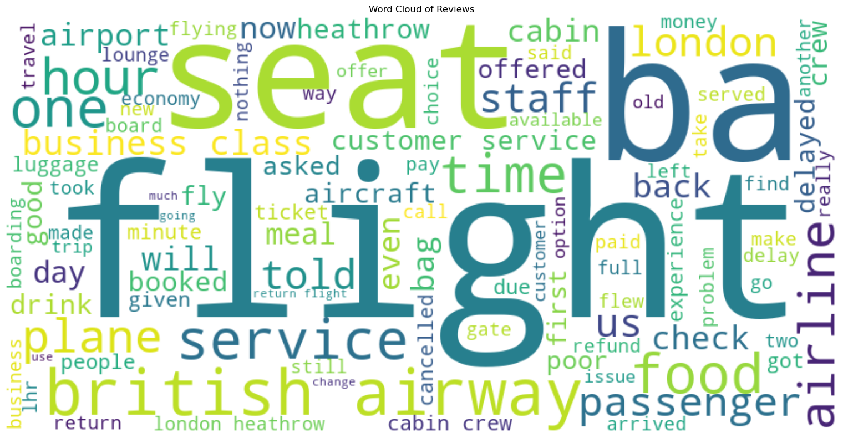
Sentiment Analysis – British Airways Review
KPI
Word Count – Negative Reviews
Total Reviews
Positive Reviews
Negative Reviews
3884
57.42%
41.29%
# Insights
Dominate complaints:
Flight
key areas for improvement:
Service
seat/seats
Food
Staff
Jose Mario Costa
Data Scientist
www.jmcloudpro.com
https://github.com/jmdtanalyst/BritshAirways_Sentiment_Analysis

